Slide 1
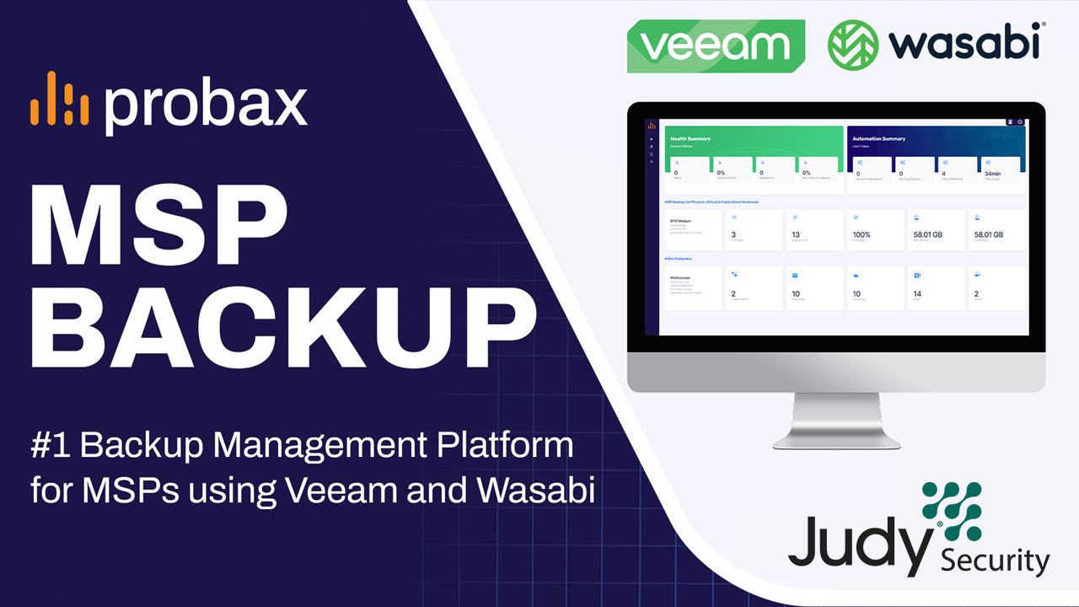

Slide 2
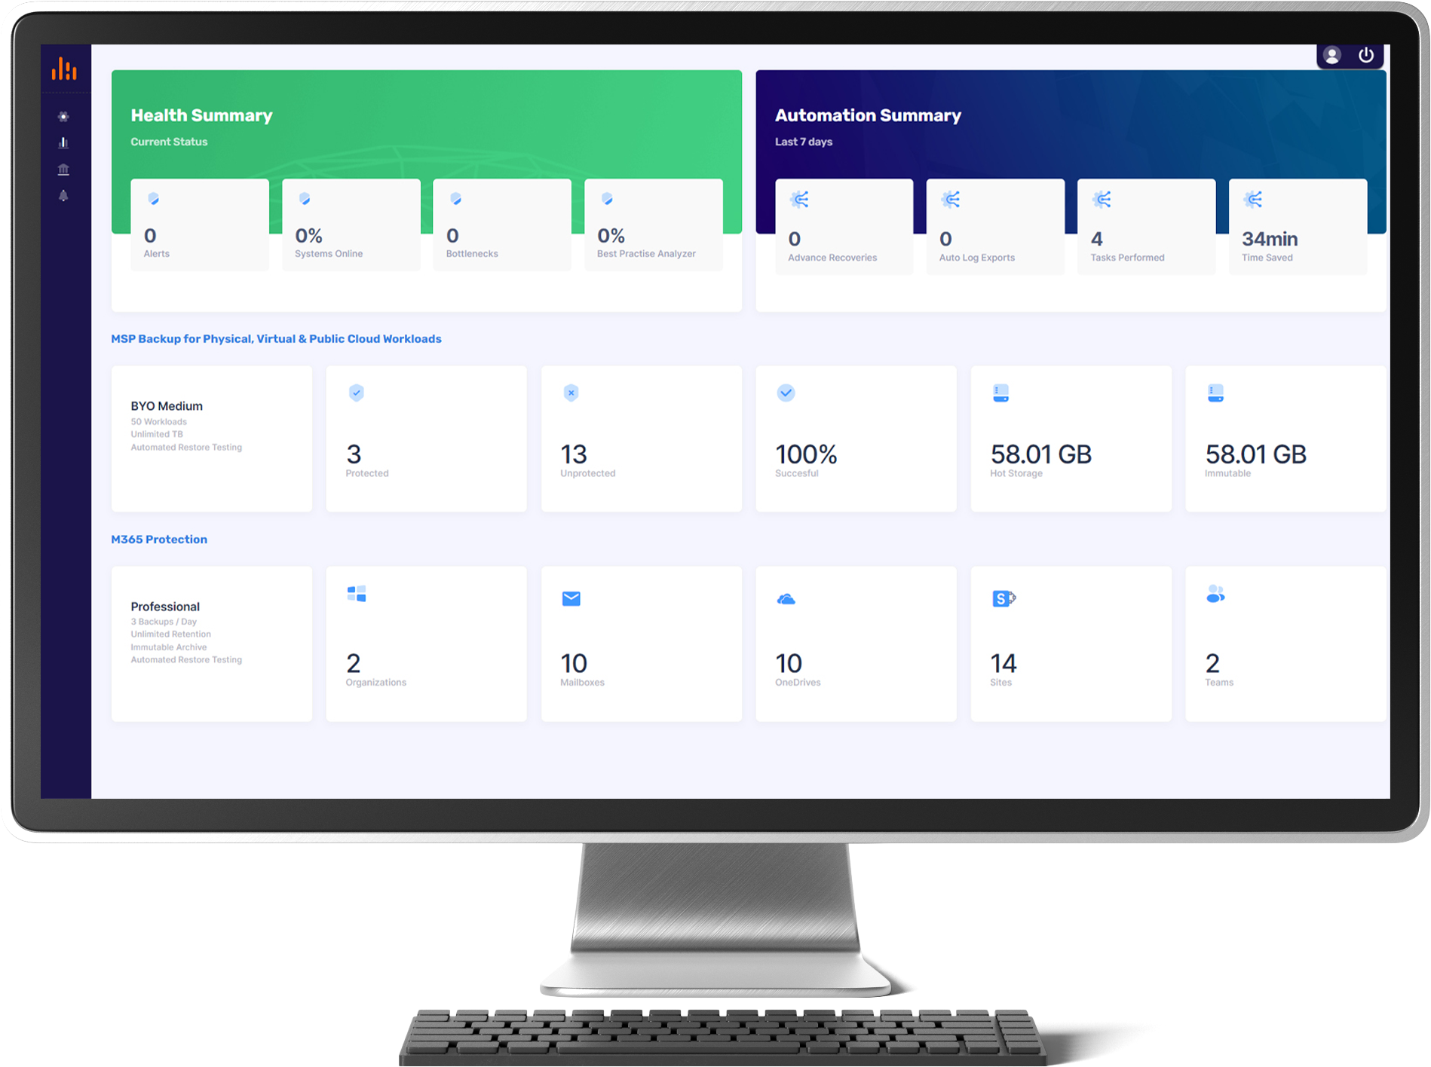

MSP Backup simplifies the enterprise grade power of Veeam and seamlessly integrates it with the, performance, value, and scalability of Wasabi
Key Features
Simplified and automated deployment of Veeam Software and Wasabi Storage
Protect physical, virtual, public cloud and Microsoft 365 workloads
Flexible month-to-month billing
Choice of Wasabi storage region, per end-client, for data sovereignty and compliance prerequisites

Slide 3
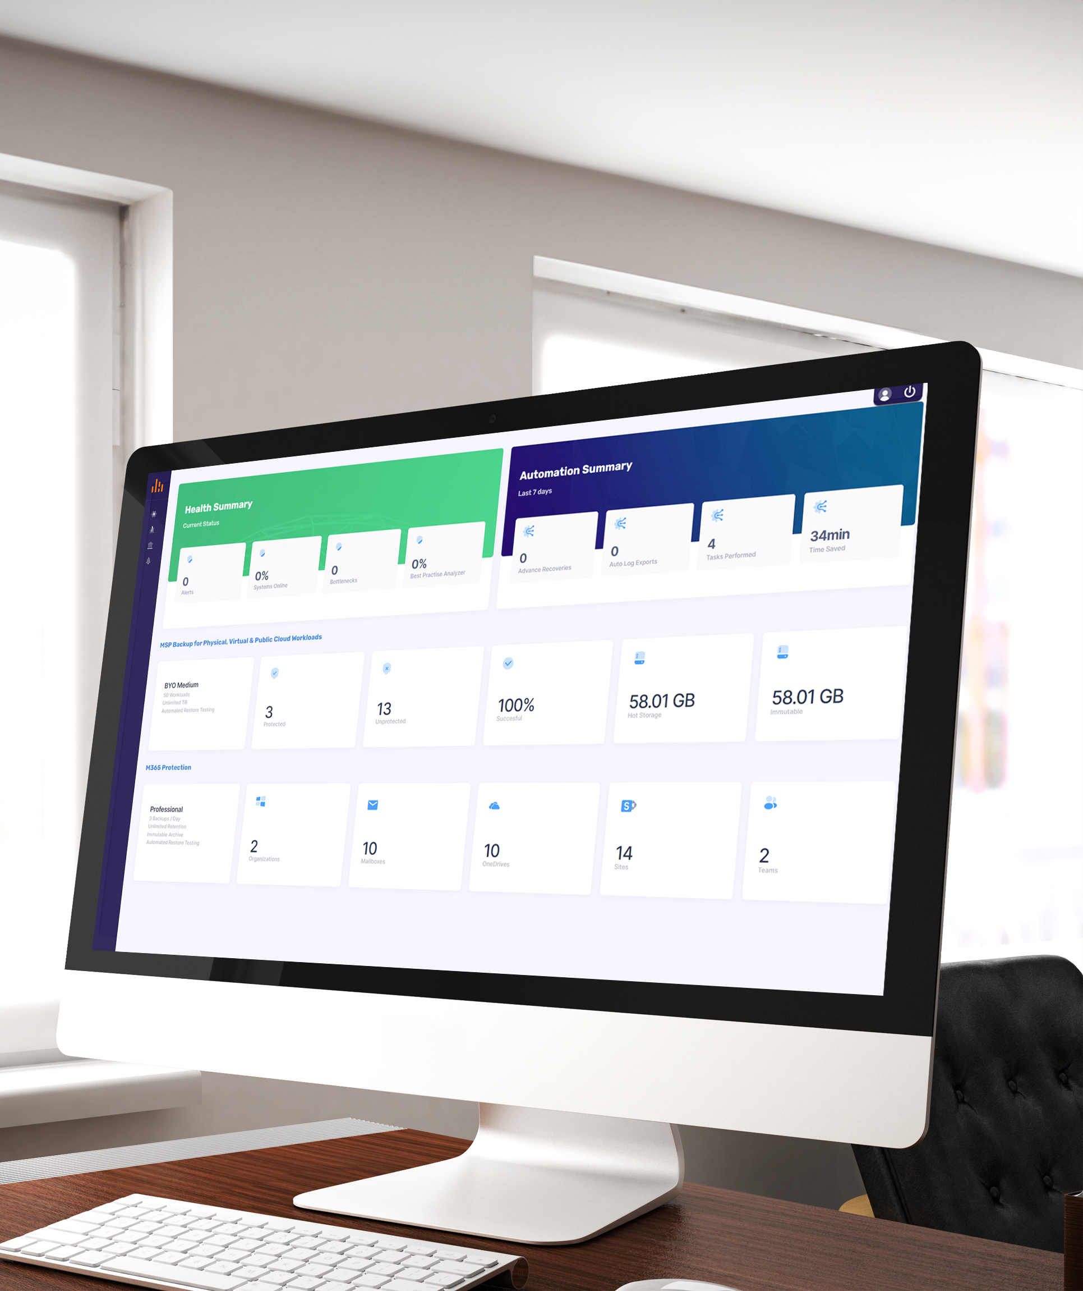
Redefining MSP Success Through Award-Winning
Veeam Innovation
Manage all clients from a centralized backup management platform:
Simplified and automated deployment of Veeam Software
Total visibility and granular control
Highly scalable
Proactive issue management
Optimal price & performance
Intuitive user interface, with end user self-service capabilities
Adaptive flexibility

Slide 4
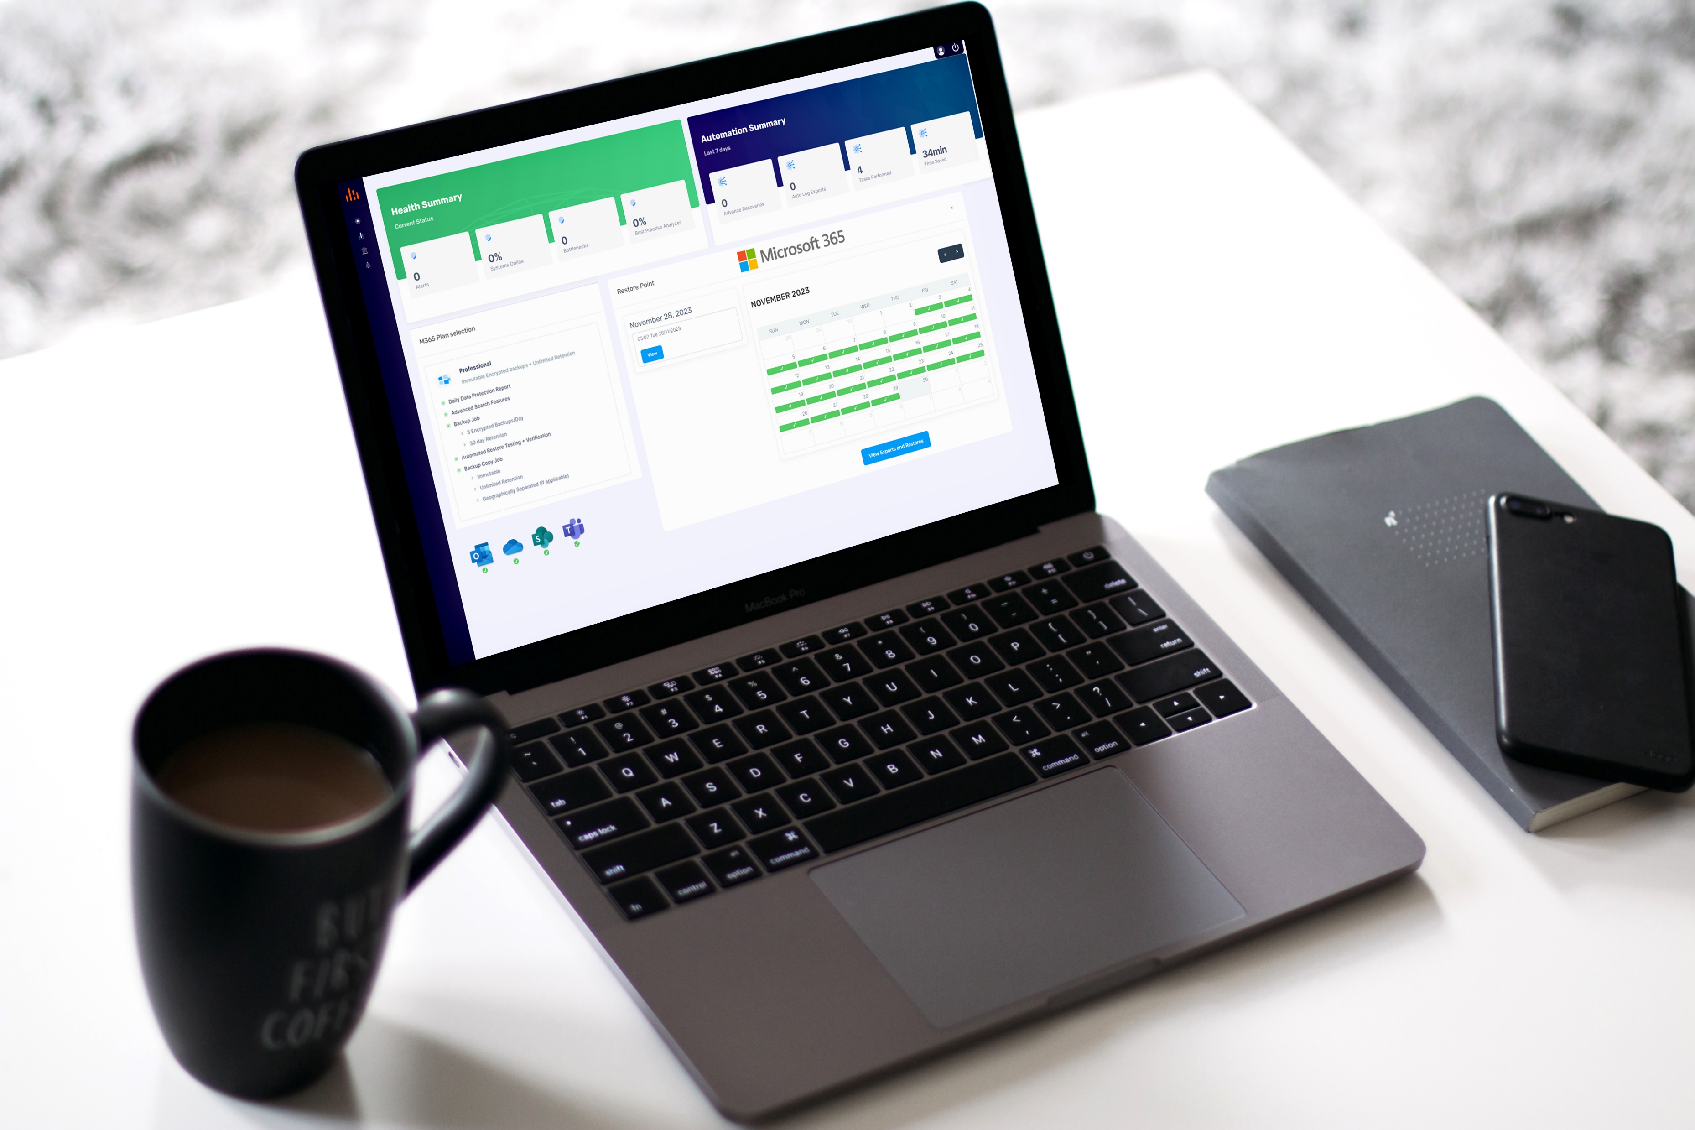
M365 Protection Evolved: Harnessing Innovative Features for Enhanced Security and Dependable Restoration
Cloud-to-cloud protection for Microsoft Exchange Online, SharePoint Online, OneDrive and Teams
Ransomware protection with end-to-end encryption and immutability
Automated test restores of every object type within each backup restore point

Slide 5


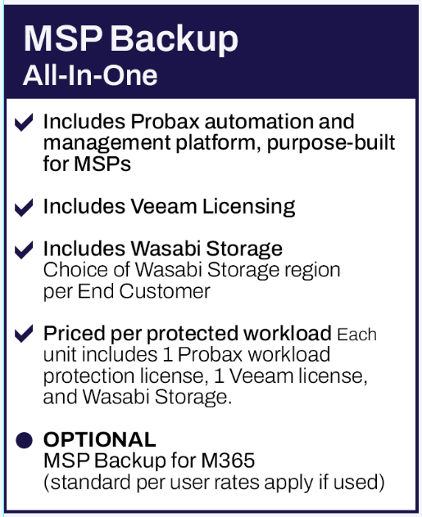
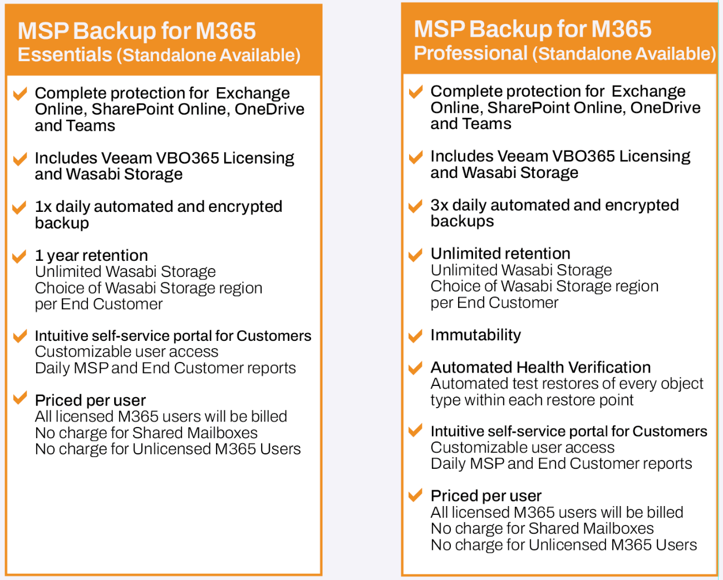
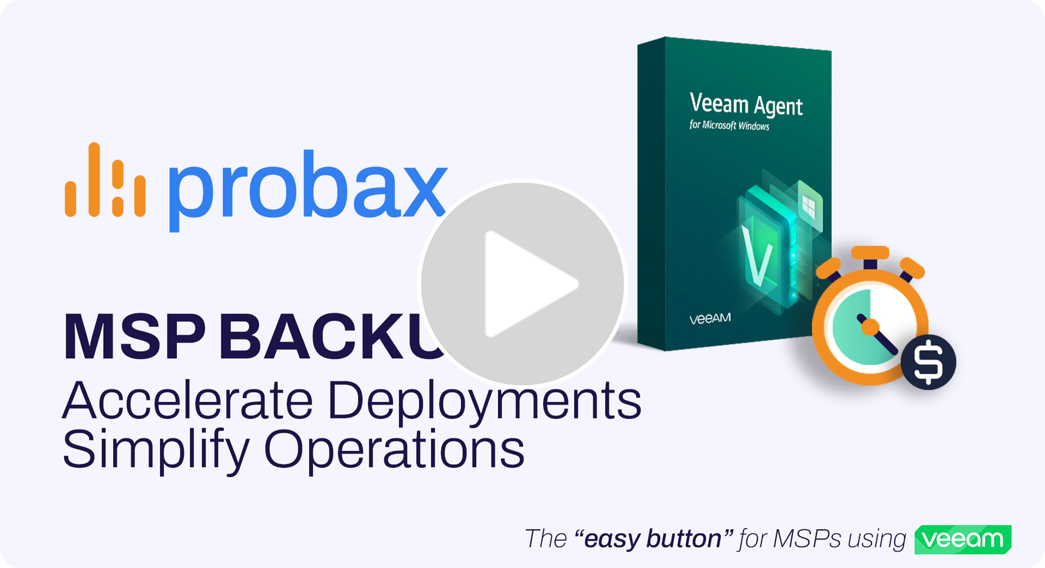
Server, Workstation, Cloud VMs & M365 Protection
MSP Backup
Flexible month-to-month plan options
Bundled with AIO or Standalone

Slide 6







Experience the Simplicity of Probax MSP Backup
This is the “Easy Button” for MSPs wanting to use Veeam with Wasabi Cloud Storage
+
+
+
Login to MSP Backup
Create New Client Account (multi-tenancy enabled)
Select Add Systems → Protect Servers and Workstations
Select Install Scout for VAW
Choose Wasabi Region (choice of region per client account)
Select Download Scout Installer
Download and install Scout Installer on initial machine
Click on Copy Hostname button at the end of setup
Paste Hostname into MSP Backup and click Update Hostname
Typically used for more complex environments and/or where custom configuration of backup jobs are needed.
Veeam Backup and Replication must be installed by the partner before proceeding
Login to MSP Backup
Create New Client Account (multi-tenancy enabled)
Select Add M365
Choose Wasabi Region (choice of region per client account)
Select M365 plan – Essentials or Professional (per client)
Authenticate with Microsoft using Global Administrator account
Login to MSP Backup
Create New Client Account (multi-tenancy enabled)
Select Add Systems → Protect Servers and Workstations
Select Install Scout for VBR
Choose Wasabi Region (choice of region per client account)
Select Download Scout Installer
Download and install Scout Installer on initial machine
Click on Copy Hostname button at the end of setup
Paste Hostname into MSP Backup and click Update Hostname
automation takes over
automation takes over
Provision new Wasabi Storage bucket
Apply correct permissions for Veeam
Apply new MSP Backup Job for M365
Commence first backup (immediate)
Provision new Wasabi Storage bucket
Scan environment for Unprotected Workloads Server & Workstation ¹
Download and install Veeam Agent for Windows (or update)
Provision VAW license via Pulse and apply license
Apply new MSP Backup Cloud Object Storage Job (will not overwrite)
Commence first daily backup at scheduled start time ²
automation takes over
Provision new Wasabi Storage bucket
Create new Object Storage Repository in VBR
Scan environment for Unprotected Workloads
Import VBR data into MSP Backup for visibility and monitoring
  Server Health - CPU, Memory & Latency in real-time
  All Backup Jobs – Start, stop or initiate full backup in MSP Backup
  All Repository Info – Type, storage usage and job information
  Veeam log event viewer – Download or auto send to Probax
  Additional settings – Send logs to Probax on best practice violations, warnings & errors. Auto backup all discovered systems
¹Unprotected workloads can be protected in just 2 clicks
²Number of restore points and start time can be set in MSP Backup. Default is 90 restore points and 6pm (local time) start time

